Slide 1
Sharing Knowledge : Best Practice Submit ARJUNA (Akreditasi Jurnal Nasional)
Binar Kurnia Prahani
Universitas Negeri Surabaya
Pendampingan Akreditasi Jurnal ‘’Penelaahan Butir Evaluasi Diri dalam Peningkatan Akreditasi Jurnal‘’
Universitas PGRI Semarang
22 Mei 2023

Slide 4
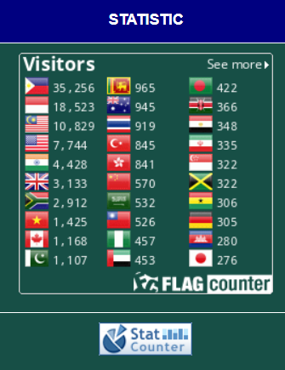
Best Practice: Studies in Learning and Teaching https://scie-journal.com/index.php/SiLeT
Optimalisasi Pengindeks (DOAJ, Copernicus)→ Diversity Penulis dan Negara
Gencarkan Call for Papers by email ke penulis LN
Poin 1 dan 2 akan optimal berdampak→ Paper In English
Kuatkan referensi dari Jurnal Internasional Bereputasi dan Mutakhir
Jejaring Editor dan Reviewer → Good Subtansi

Slide 5
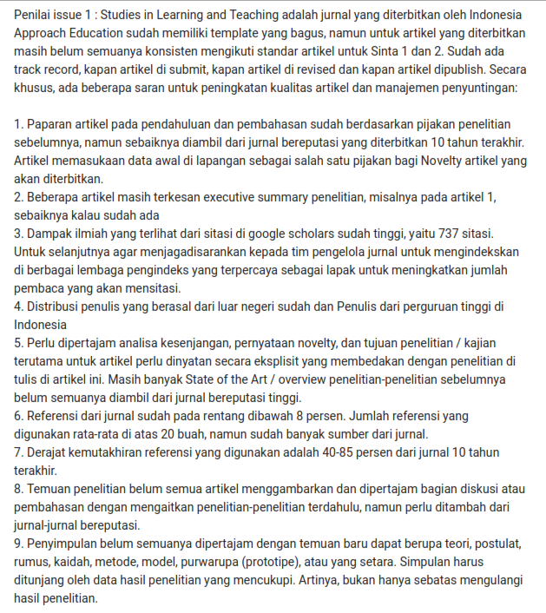

Slide 8
Terima Kasih
Dr. Binar Kurnia Prahani, M.Pd.
E-mail : binarprahani@unesa.ac.id. ; binarprahani@gmail.com
Home Base : Universitas Negeri Surabaya
Produk : Document Scopus [88 Published] ; 23 Hak Cipta; 10 Buku
Riset : Emerging Technology in Innovative Science-Physics Learning ; Bibliometric ; EDR ; HOTs
Pengelola & Pengabdian 2023 :
Kepala Subdirektorat Publikasi Ilmiah dan Pengelolaan Konferensi Unesa
Editor in Chief di IJORER : International Journal of Recent Educational Research
Managing Editor di Studies in Learning and Teaching (SINTA 2)
Reviewer Scopus Q1 (Computers & Education; Behaviour and Information Technology; Reflective Practice; Heliyon; BMC Medical Education; Contemporary Educational Technology) dll

